Slide 1
Lesson 2: Bulk-RNA
Part I
Jaehyun Lee

Slide 2
Topics
General Information and Pipeline of Bulk-RNA
Quality Control
Exploratory analysis
Differential Gene Expression Analysis (DGE)
Why and what is DGE?
Most used Algorithms/Software
General Linear modelling and Representation of Data
Batch and technical effects correction
Interpretation and Visualization
Summary

Slide 3
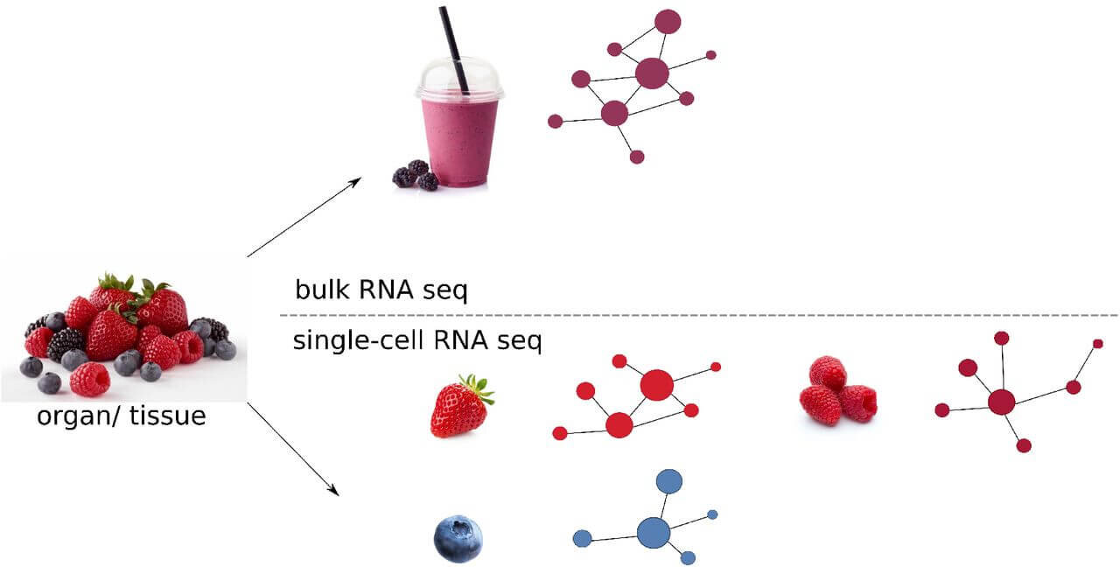
General Information and Pipeline of Bulk-RNA
Mapping
Quality Control
Exploratory Analysis
Batch Correction
DGE
1 sample == 1 patient
Often used to compare a condition vs control in a genome wide scale
Routine-like analysis with many established pipelines
Solid foundation to start transcriptomics and learn the basics of DGE

Slide 4
2. Quality Control + Exploratory Analysis
Mapping
Quality Control
Exploratory Analysis
Batch Correction
DGE
count matrix
low count filtering
normalization
hierarchical clustering
PCA
Dispersion plot
MA plot (quickly mention shrinkage)
size factor plot
Finding batch effects
SVA

Slide 5
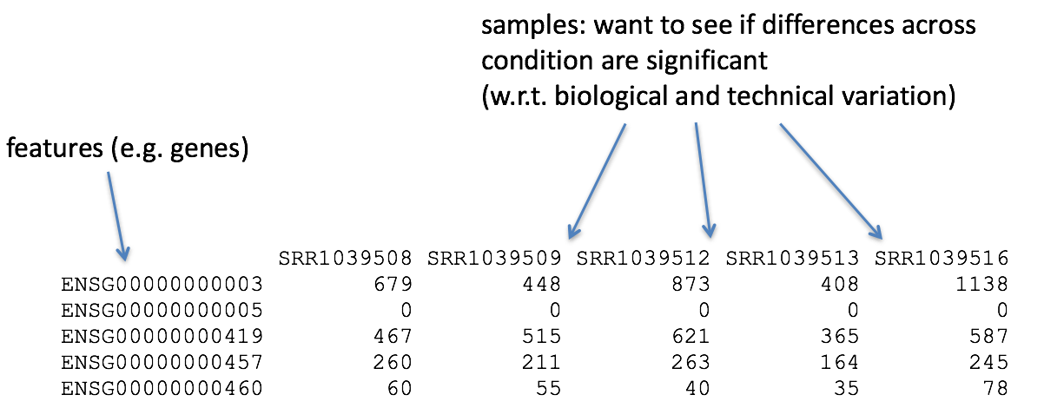
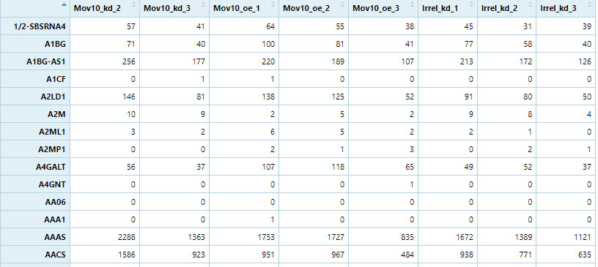
2. Quality Control + Exploratory Analysis
Mapping
Quality Control
Exploratory Analysis
Batch Correction
DGE
Why not just rank the genes according to difference in expression?
Sample Variability
Sample Variability
Biological variability
Unknown
Biological variability
Known
Technical variability
Technical variability

Slide 6
2. Quality Control + Exploratory Analysis
Mapping
Quality Control
Exploratory Analysis
Batch Correction
DGE
count matrix
low count filtering
normalization
hierarchical clustering
PCA
Dispersion plot
size factor plot
Finding batch effects
SVA

Slide 7
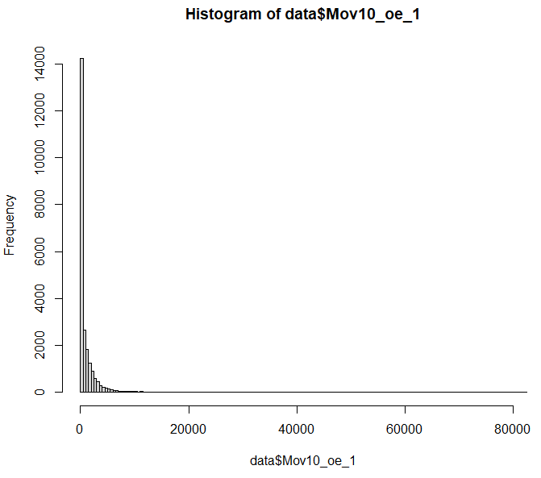
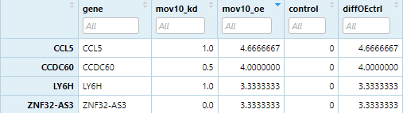
2. Quality Control + Exploratory Analysis
Mapping
Quality Control
Exploratory Analysis
Batch Correction
DGE
RNA-seq data tends to have a a lot of genes with low counts
This is due sequencing depth and the nature of sequencing genes
biological? technical?

Slide 8
2. Quality Control + Exploratory Analysis
Mapping
Quality Control
Exploratory Analysis
Batch Correction
DGE
Gene name | Rep1 | Rep2 | Rep3
A | 10 | 12 | 30
B | 20 | 25 | 60
C | 5 | 8 | 15
D | 0 | 0 | 1
Library size | 35 | 45 | 106
Many different methods for normalization + a lot of new ones being made
Process is always the same: Take library size (and variation) to normalize all counts
How to find out if raw or normalized:
normalized counts are numeric
raw counts are integer
Notes:
DESeq2 normalization: https://www.youtube.com/watch?v=UFB993xufUU

Slide 9
2. Quality Control + Exploratory Analysis
Mapping
Quality Control
Exploratory Analysis
Batch Correction
DGE
count matrix
low count filtering
normalization
hierarchical clustering
PCA
Dispersion plot
size factor plot
Finding batch effects
SVA
All of this will happen in DESeq2!

Slide 10
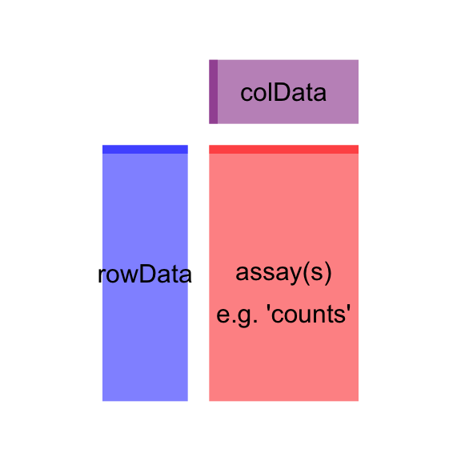
2. Quality Control + Exploratory Analysis
Mapping
Quality Control
Exploratory Analysis
Batch Correction
DGE
What is DESeq2?
R package designed for differential expression analysis
introduces the DESeqDataSet format
metadata: information about samples
rowData: information about genes

Slide 11
2. Quality Control + Exploratory Analysis
Mapping
Quality Control
Exploratory Analysis
Batch Correction
DGE
count matrix
low count filtering
normalization
size factor plot
Dispersion plot
hierarchical clustering
PCA
Finding batch effects
SVA
Just visualizations to determine data quality and check if further filtering is needed

Slide 12
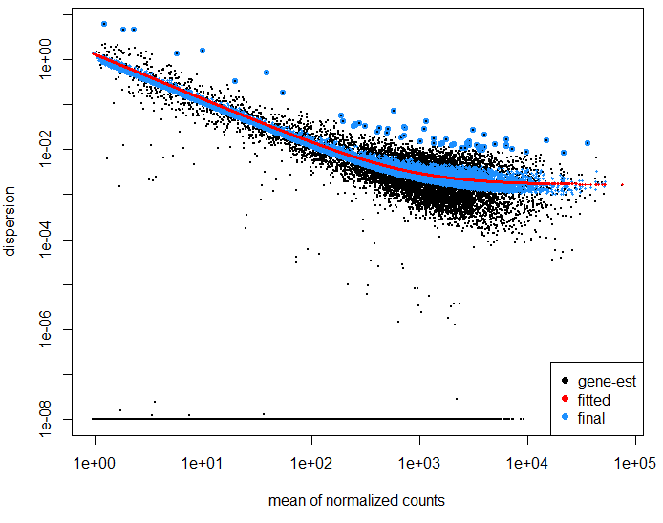
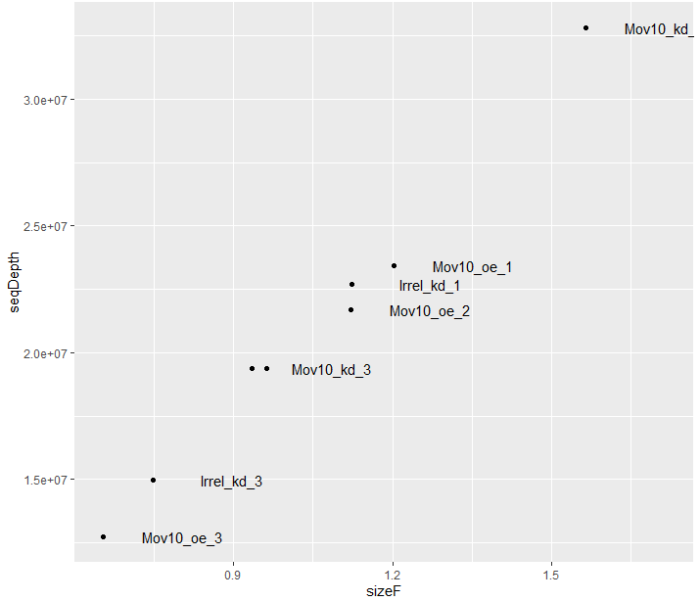
2. Quality Control + Exploratory Analysis
Mapping
Quality Control
Exploratory Analysis
Batch Correction
DGE
Dispersion Plot
Size Factor Plot

Slide 13
2. Quality Control + Exploratory Analysis
Mapping
Quality Control
Exploratory Analysis
Batch Correction
DGE
Dispersion Plot
measuring dispersion/variation per gene against the mean of normalized counts
The dispersion for each gene is calculated by maximum likelihood
A global/local fit line is made across all dispersions
Shrink the dispersion towards the fit -> Improves statistic for later
Detect outliers, which will not be corrected but flagged -> removing potential technical effects

Slide 14
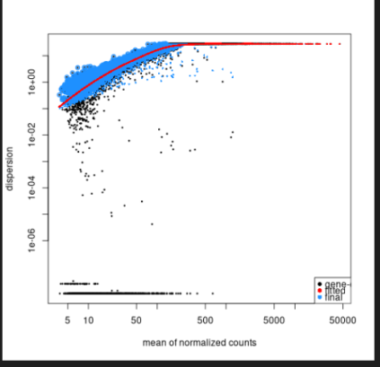
2. Quality Control + Exploratory Analysis
Mapping
Quality Control
Exploratory Analysis
Batch Correction
DGE
Good Fit
Bad Fit
Check:
A lot of low dispersion?
Fit graph looks normal?
Some differential genes?
3
3
2
2
1
1

Slide 15
2. Quality Control + Exploratory Analysis
Mapping
Quality Control
Exploratory Analysis
Batch Correction
DGE
count matrix
low count filtering
normalization
size factor plot
Dispersion plot
MA plot (quickly mention shrinkage)
hierarchical clustering
PCA
Finding batch effects
SVA
Visualizations to find potential batch effects and also determine data quality

Slide 16
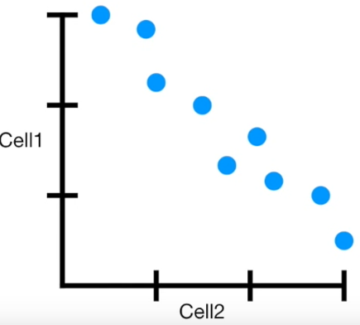
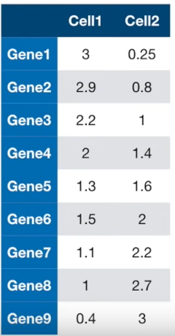
2. Quality Control + Exploratory Analysis
Mapping
Quality Control
Exploratory Analysis
Batch Correction
DGE
Finding a correlation between two samples is easy
Just draw a 2D diagram
Notes:
PCA main ideas: https://www.youtube.com/watch?v=HMOI_lkzW08
PCA step by step: https://www.youtube.com/watch?v=FgakZw6K1QQ&t=526s

Slide 17
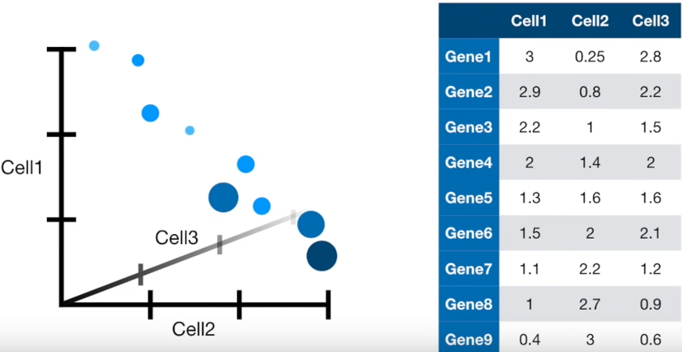
2. Quality Control + Exploratory Analysis
Mapping
Quality Control
Exploratory Analysis
Batch Correction
DGE
Finding a correlation between three samples is doable
Just draw a 3D diagram
Notes:
PCA main ideas: https://www.youtube.com/watch?v=HMOI_lkzW08
PCA step by step: https://www.youtube.com/watch?v=FgakZw6K1QQ&t=526s

Slide 18
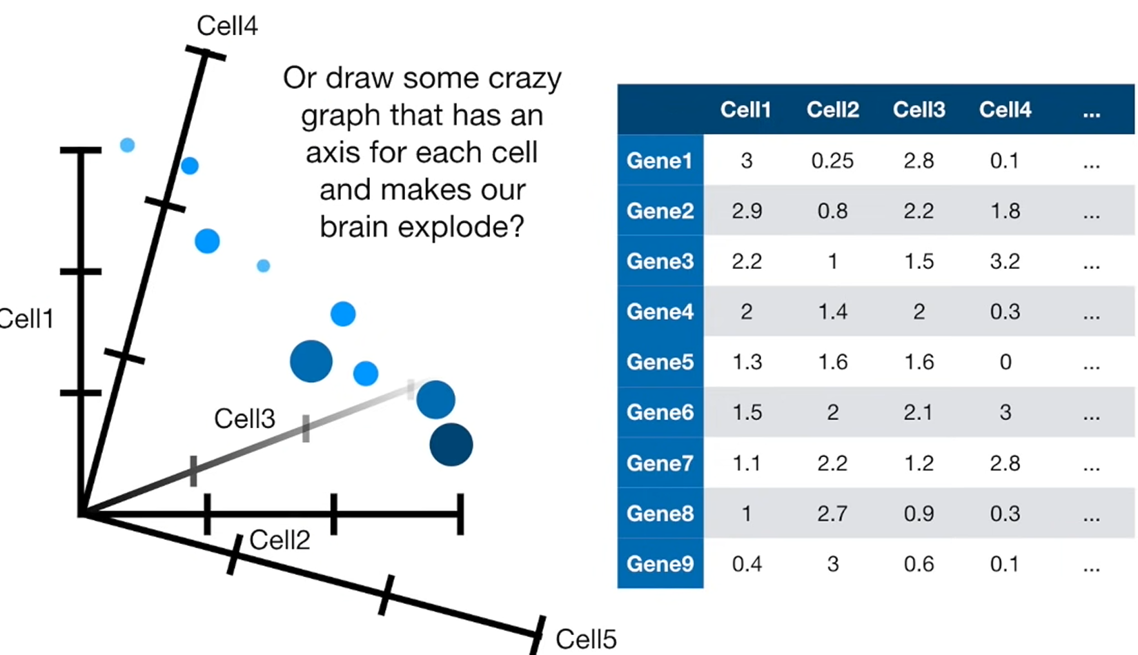
2. Quality Control + Exploratory Analysis
Mapping
Quality Control
Exploratory Analysis
Batch Correction
DGE
And now….?
NGS sequencing is always a multi dimensional dataset!
-> Dimensional Reduction Methods for visualization!
PCA, UMAP, t-SNE, …
Notes:
PCA main ideas: https://www.youtube.com/watch?v=HMOI_lkzW08
PCA step by step: https://www.youtube.com/watch?v=FgakZw6K1QQ&t=526s

Slide 19
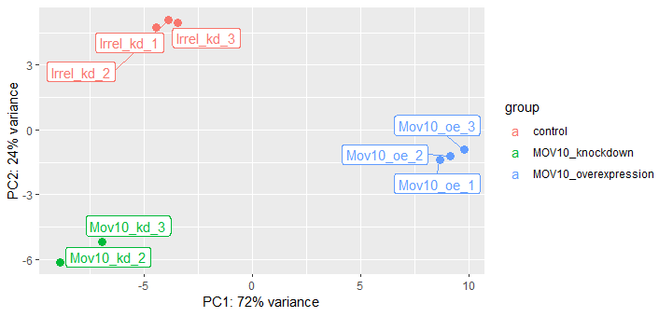
2. Quality Control + Exploratory Analysis
Mapping
Quality Control
Exploratory Analysis
Batch Correction
DGE
Notes:
PCA main ideas: https://www.youtube.com/watch?v=HMOI_lkzW08
PCA step by step: https://www.youtube.com/watch?v=FgakZw6K1QQ&t=526s

Slide 20
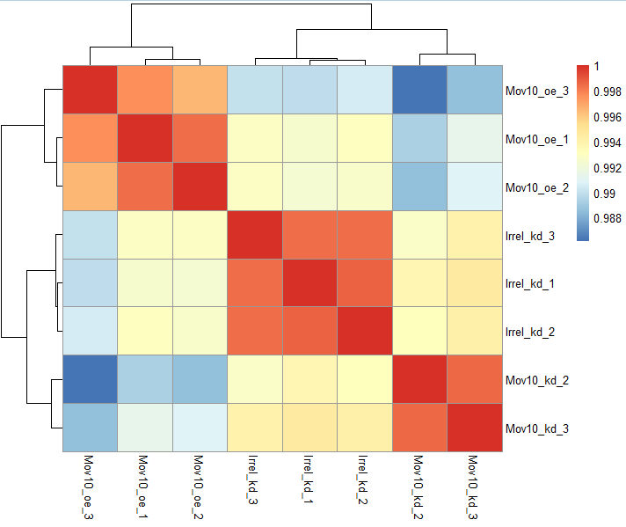
2. Quality Control + Exploratory Analysis
Mapping
Quality Control
Exploratory Analysis
Batch Correction
DGE
Hierarchical Clustering:
Clustering: Taking sample together based on similarity/distance measures
Hierarchical: finding clusters one after another in a ranked manner
Notes:
Video explaining it well: https://www.youtube.com/watch?v=7xHsRkOdVwo&t=272s

Slide 21
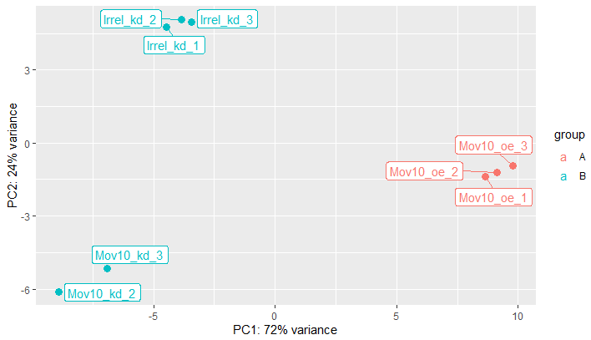
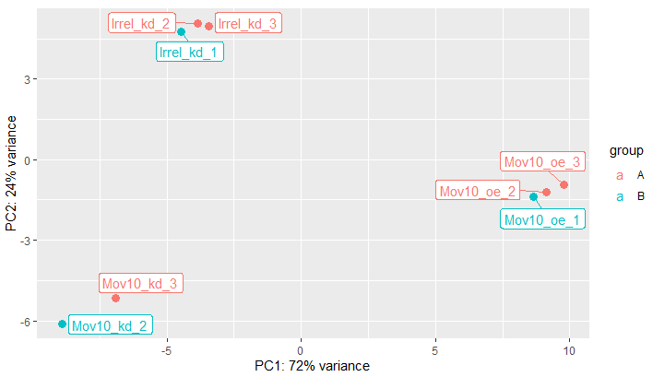
2. Quality Control + Exploratory Analysis
Mapping
Quality Control
Exploratory Analysis
Batch Correction
DGE
Bad
Good
Confounded Batch effect
Not confounded
Confounded Batch effect:
Batches overlap with condition!
Level of confounding can vary
This is no problem (basically sample variability)
But still some unknown effects
Notes:
PCA main ideas: https://www.youtube.com/watch?v=HMOI_lkzW08
PCA step by step: https://www.youtube.com/watch?v=FgakZw6K1QQ&t=526s

Slide 22
2. Quality Control + Exploratory Analysis
Mapping
Quality Control
Exploratory Analysis
Batch Correction
DGE
count matrix
low count filtering
normalization
size factor plot
Dispersion plot
MA plot (quickly mention shrinkage)
hierarchical clustering
PCA
Finding batch effects
SVA
Correcting for unknown effects

Slide 23
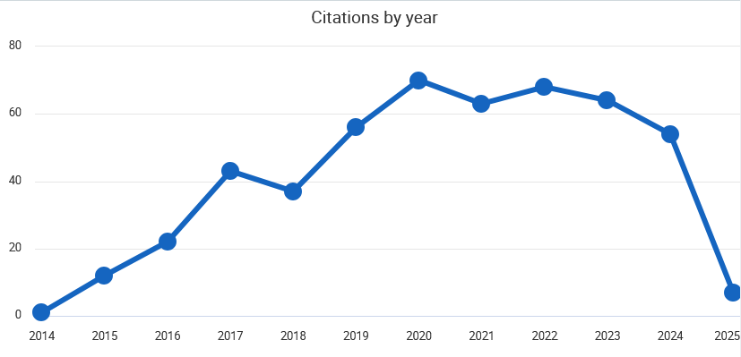
2. Quality Control + Exploratory Analysis
Mapping
Quality Control
Exploratory Analysis
Batch Correction
DGE
sva paper: https://academic.oup.com/nar/article/42/21/e161/2903156?login=false
Method has been out since 2014

Slide 24
4. Summary
RNA-seq have low counts
Library size differences have to normalized
Explorative analysis important to find:
Quality of data acceptable? And any other processing necessary?
Batch effects we have to be careful about?
In differential expression it is always a balancing between correcting out unwanted variation and keeping desired biological variation
Explorative Analysis almost more important than the actual analysis!

Slide 25
Sources and extra
Data: https://www.ncbi.nlm.nih.gov/geo/query/acc.cgi?acc=GSE50499
R and R studio: https://cran.r-project.org/ ; https://posit.co/products/open-source/rstudio/
Very good tutorial: https://hbctraining.github.io/DGE_workshop/schedule/1.5-day.html
Good example for modelling: https://www.youtube.com/watch?v=HK7WKsL3c2w
DESeq2 normalization: https://www.youtube.com/watch?v=UFB993xufUU
Good video explaining different kinds of classic normalizations: https://www.youtube.com/watch?v=S1PcT5rp8c4&pp=ygUVbm9ybWFsaXphdGlvbiBybmEgd2h5
Generally good channel for more technical explanations of topics: https://www.youtube.com/@statquest
sva paper: https://academic.oup.com/nar/article/42/21/e161/2903156?login=false
PCA main ideas: https://www.youtube.com/watch?v=HMOI_lkzW08
PCA step by step: https://www.youtube.com/watch?v=FgakZw6K1QQ&t=526s
Hierarchical clustering: https://www.youtube.com/watch?v=7xHsRkOdVwo&t=272s

Slide 26
Lesson 2: Bulk-RNA
Part II
Jaehyun Lee

Slide 27
Topics
General Information and Pipeline of Bulk-RNA
Quality Control
Exploratory analysis
Differential Gene Expression Analysis (DGE)
Why and what is DGE?
Most used Algorithms/Software
General Linear modelling and Representation of Data
Batch and technical effects correction
Interpretation and Visualization
Summary

Slide 28
Quick recap
We should have:
good quality data
defined comparisons, number of samples etc.
found possible batch effects

Slide 29
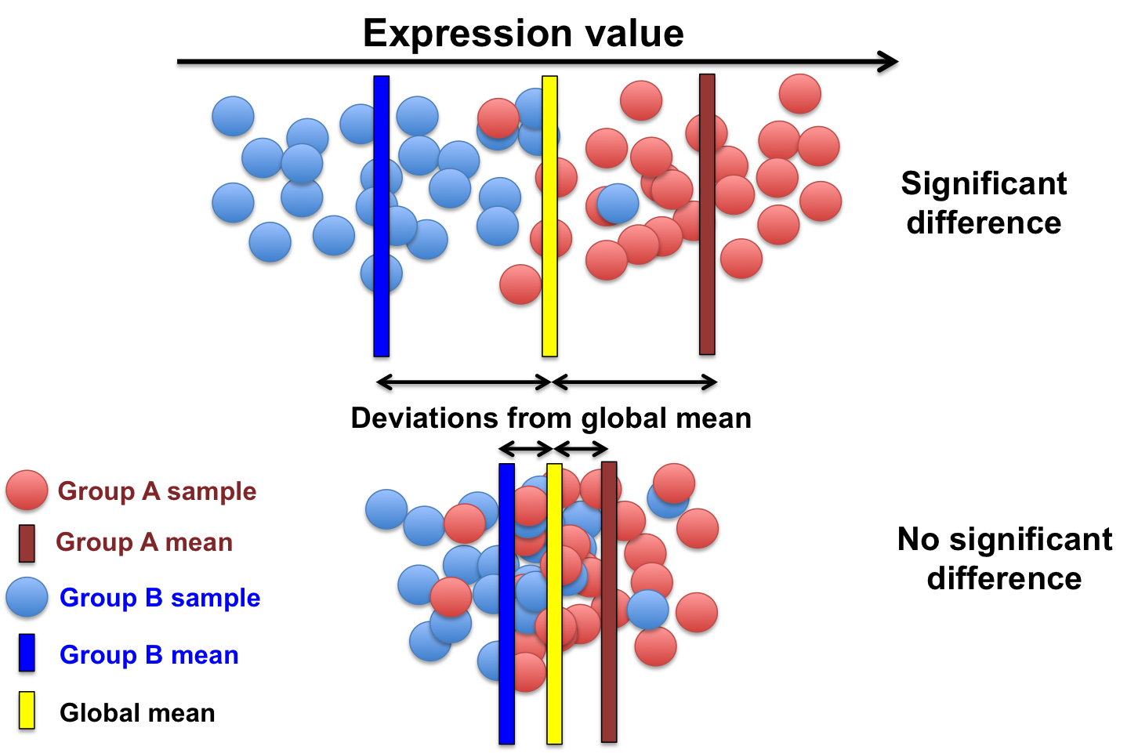
3.1 Differential Gene Expression Analysis: What and Why?
What is Differential Gene Expression Analysis (DGE)?
changes from WT to condition
finding genes that are significantly up or down regulated
How to determine and define “significant”?
based on statistical modelling
based on p-value/FDR
linear models
biocorecrg.github.io

Slide 30
3.2 Most used Algorithms/Software/Methods
t-test
ANOVA
kruskal wallis test
Wilcoxon test
DESeq2
limma
edgeR
generalized linear modelling

Slide 31
3.2 Most used Algorithms/Software/Methods
DESeq2
My choice
Wald and LRT testing
Very good documentation
The author (Michael Love) is very active on biostars and other forums
edgeR: similar to deseq2 with minor differences in modelling and normalization
limma: better for your own linear modelling
The choice of method, package and algorithm depends on the design of the experiment. For more complex statistical modellings limma might be better. But for most of tests, DESeq2 is good.

Slide 32
3.3 General Linear Modelling and Data Representation
I am extremely simplifying here!!
This is the most complex part with high statistical/algebra mathematics
based on multiple decades of statistical development with many many field changing researchers and papers
Steps are always the same:
Design a comparison function/design matrix (linear modelling)
Choose the most optimal distribution (normal? negative binomial? poisson?...)
Find the best fit distribution function to data (maximum likelihood)
Use fit distribution to do hypothesis testing (wald test, likelihood ratio test…)
Notes:
Explaining Wald test: https://www.youtube.com/watch?v=TFKbyXAfr1M
Explaining maximum likelihood: https://www.youtube.com/watch?v=XepXtl9YKwc (for more mathematical look for Ben Lambert)
Explaining Linear modelling: https://www.youtube.com/watch?v=R7xd624pR1A

Slide 33
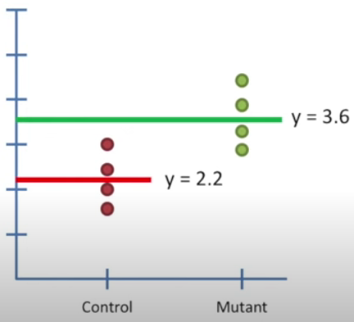
3.3.1 Design a comparison function/design matrix (linear modelling)
~ condition (how linear model looks in DESeq2)
-> y = a * mean(control) + b * mean(condition) + residual
a and b can be either one or zero
if a = 1, b must be 0 (and other way around)
residual is from the dot/replicate we are representing
so the function above can describe all the points:
y_ctrl1 = 1 * mean(control) + 0*mean(condition) + residual of control replicate1
y_ctrl2 = 1 * mean(control) + 0*mean(condition) + residual of control replicate2
y_cond1 = 1 * mean(control) + 0*mean(condition) + residual of condition replicate1
…
Notes:
Explaining Wald test: https://www.youtube.com/watch?v=TFKbyXAfr1M
Explaining maximum likelihood: https://www.youtube.com/watch?v=XepXtl9YKwc (for more mathematical look for Ben Lambert)
Explaining Linear modelling: https://www.youtube.com/watch?v=R7xd624pR1A

Slide 34
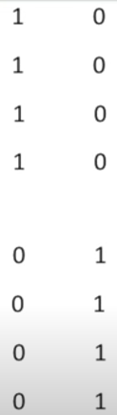
3.3.1 Design a comparison function/design matrix (linear modelling)
~ condition (how linear model looks in DESeq2)
-> y = a * mean(control) + b * mean(condition) + residual
As residuals, a and b is variable by replicate one can summarize to:
y = a * control + b * condition (control/condition containing all the residuals)
In computation this can be set as a binary design matrix
Thus, in code we only need to define the metadata column we want to categorize in binary:
~ condition
-> this will look into the condition column in meta, get the groups and turn it into a binary design matrix
Notes:
Explaining Wald test: https://www.youtube.com/watch?v=TFKbyXAfr1M
Explaining maximum likelihood: https://www.youtube.com/watch?v=XepXtl9YKwc (for more mathematical look for Ben Lambert)
Explaining Linear modelling: https://www.youtube.com/watch?v=R7xd624pR1A

Slide 35
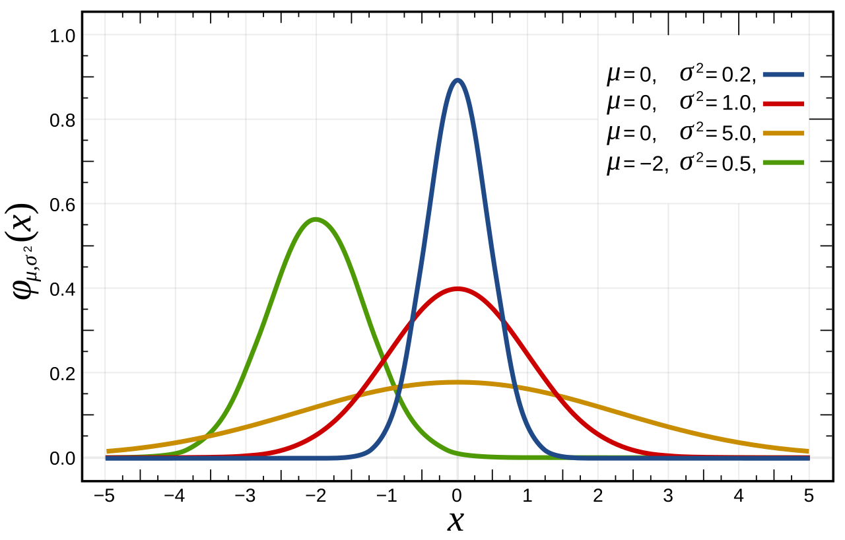
3.3.2 Distribution + Maximum Likelihood
Choosing the distribution between Normal, Negative Binomial or Poisson
This is usually done automatically
Each distribution looks different based on mean and variance
Notes:
Explaining Wald test: https://www.youtube.com/watch?v=TFKbyXAfr1M
Explaining maximum likelihood: https://www.youtube.com/watch?v=XepXtl9YKwc (for more mathematical look for Ben Lambert)
Explaining Linear modelling: https://www.youtube.com/watch?v=R7xd624pR1A

Slide 36
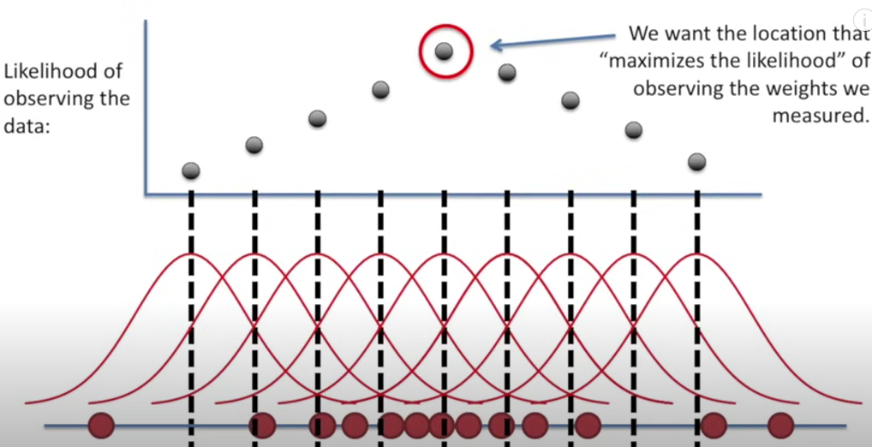
3.3.2 Distribution + Maximum Likelihood
Maximum Likelihood is the process to fit the chosen distribution to your count data
getting µ and σ
Notes:
Explaining Wald test: https://www.youtube.com/watch?v=TFKbyXAfr1M
Explaining maximum likelihood: https://www.youtube.com/watch?v=XepXtl9YKwc (for more mathematical look for Ben Lambert)
Explaining Linear modelling: https://www.youtube.com/watch?v=R7xd624pR1A

Slide 37
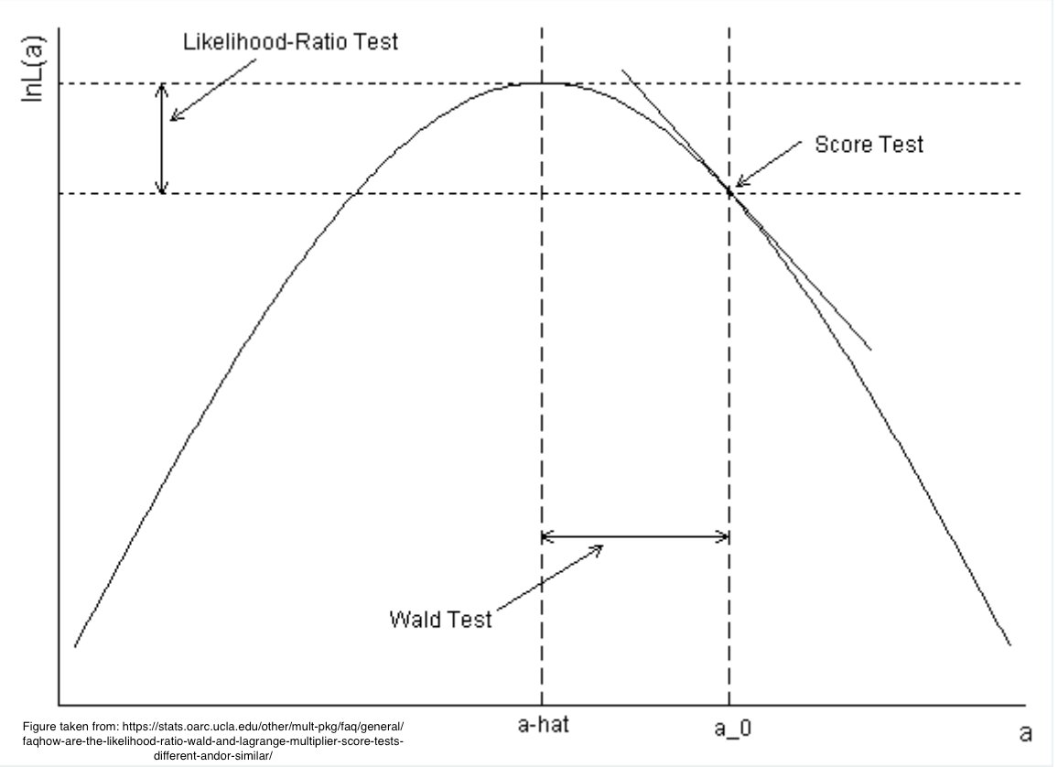
3.3.3 Hypothesis Testing
Using the Maximum Likelihood distribution we do hypothesis testing
H0 = no change
LRT or Wald
Notes:
Explaining Wald test: https://www.youtube.com/watch?v=TFKbyXAfr1M
Explaining maximum likelihood: https://www.youtube.com/watch?v=XepXtl9YKwc (for more mathematical look for Ben Lambert)
Explaining Linear modelling: https://www.youtube.com/watch?v=R7xd624pR1A
Explaining Liklihood Ratio Test: https://www.youtube.com/watch?v=Tn5y2i_MqQ8

Slide 38
3.4 Batch effect correction
~ condition
This design will lead to function representing only the condition groups
~ batch1 + batch2 + condition
This design will represent batches and the condition groups
This will change the distribution fitting and linear modelling of the test -> The condition comparison is now corrected for the batch effects
Imagine it as shifting the graph by adding more parameters
The batch information has to be non-overlapping with the condition
Overlapping:
If 1 group can be represented by another group it is overlapping
This also holds true if a part of the grouping is the same as another group

Slide 39
3.5 Interpretation and Visualization
After DESeq2 you will have results saved in the object
resultsnames gives you the individual results of your design (~ SV1 + SV2 + sampletype)
You can get the desired result table by defining the contrast
This will lead to a data frame of the result table: Here is the first row

Slide 40
3.5 Interpretation and Visualization
row names are the genes
baseMean: normalized mean expression level of the gene across conditions
log2FoldChange: log2 transformed Fold Change between conditions (care contrast)
lfcSE: shrinked log2FoldChange (does it by default but not really shrunk)
stat: Wald statistic, which is used to calculate the pvalue (like t-statistic in t-tests)
pvalue: p-value
padj: for multiple testing adjusted p-value
Each of these are very important and have their usages
Today we will only look at functionalities of lfcSE, pvalue, and padj

Slide 41
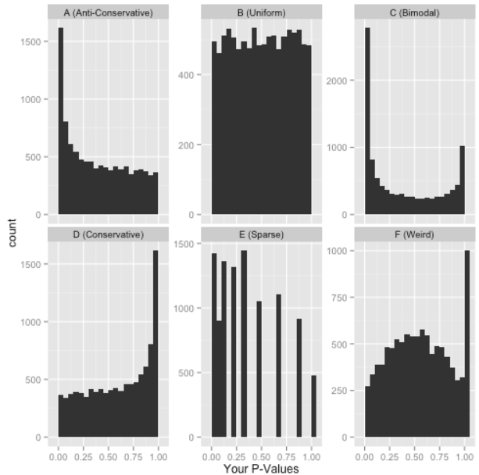
3.5 Interpretation and Visualization: pvalue
pvalue: calculated from stat
histogram of pvalue can give us good insights about the quality of testing
Anti-Conservative: Good! You got results!
Uniform: Good! You know there is no difference between conditions
Everything else: Something is going on…
one sided test? wrong test?
padj instead of pvalue?
LRT test? (here a high peak at 1 is fine)
Notes:
Good basic explanation on pvalue histograms: http://varianceexplained.org/statistics/interpreting-pvalue-histogram/

Slide 42
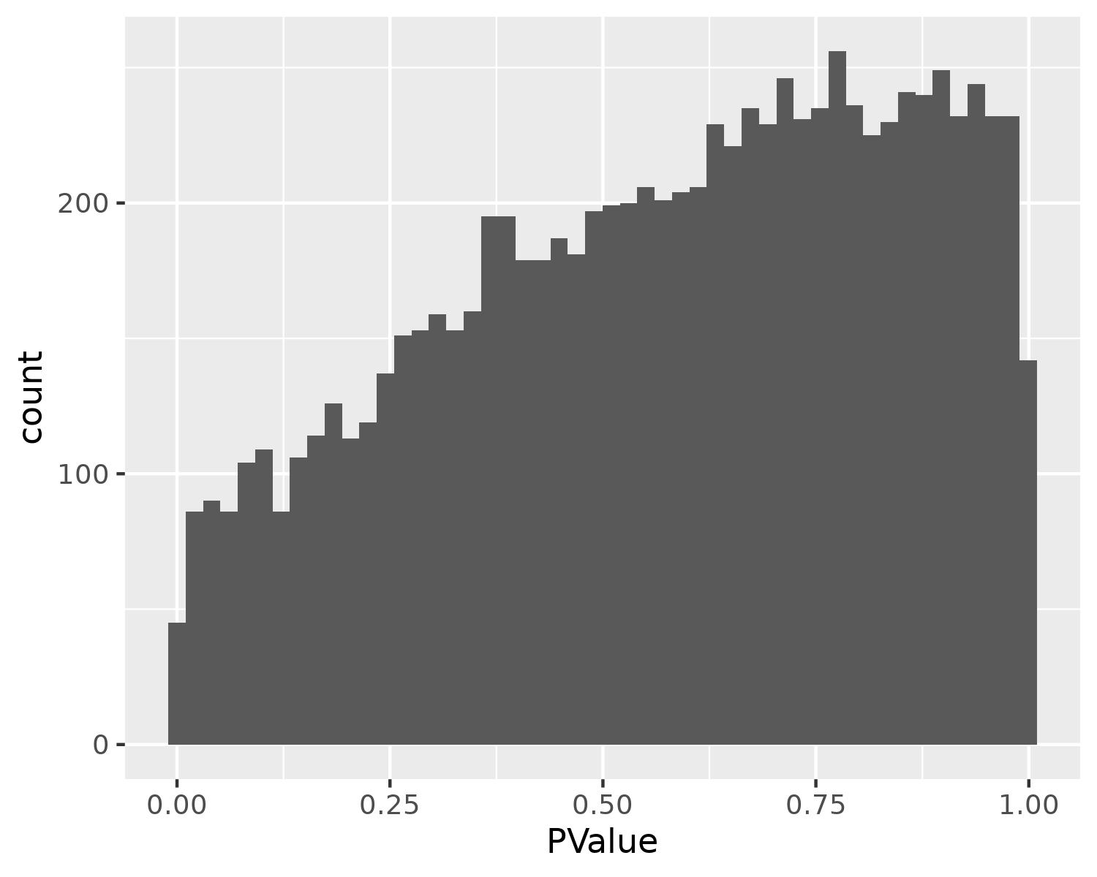
3.5 Interpretation and Visualization: pvalue
pvalue: Hill shaped histogram
This means the pvalues were not well fit
Think back when we were fitting our distribution to our data
There we calculate µ and σ to get the maximum likelihood
But this is actually not the case in most of algorithms
Most algorithms only calculate µ (why is a good question that has a 50 page answer)
Mostly only µ is fine but for certain data we also have to calculate σ
-> recalculate the fit using stat -> fdrtool
Notes:
Good basic explanation on pvalue histograms: http://varianceexplained.org/statistics/interpreting-pvalue-histogram/
Discussion on hill shaped histogram: https://support.bioconductor.org/p/71438/

Slide 43
3.5 Interpretation and Visualization: padj
padj: adjusted p-value
We do multiple tests during the differential analysis as we have to test every gene
Usually between 15 000 to 25 000 tests
The more tests you do, the higher the chances to find a random significance by chance
We are already accepting a 5% error rate, but accepting it over 20 000 tests increase danger of false positives!
-> Multiple testing correction
- Many methods: Benjamini-Hochberg (BH), Bonferroni,...
- BH used the most: padj = p-value * nTests/rank
Rank p-values
Recalculate each p-value according to their rank
Use padj to set significance (padj/FDR/q-value)

Slide 44
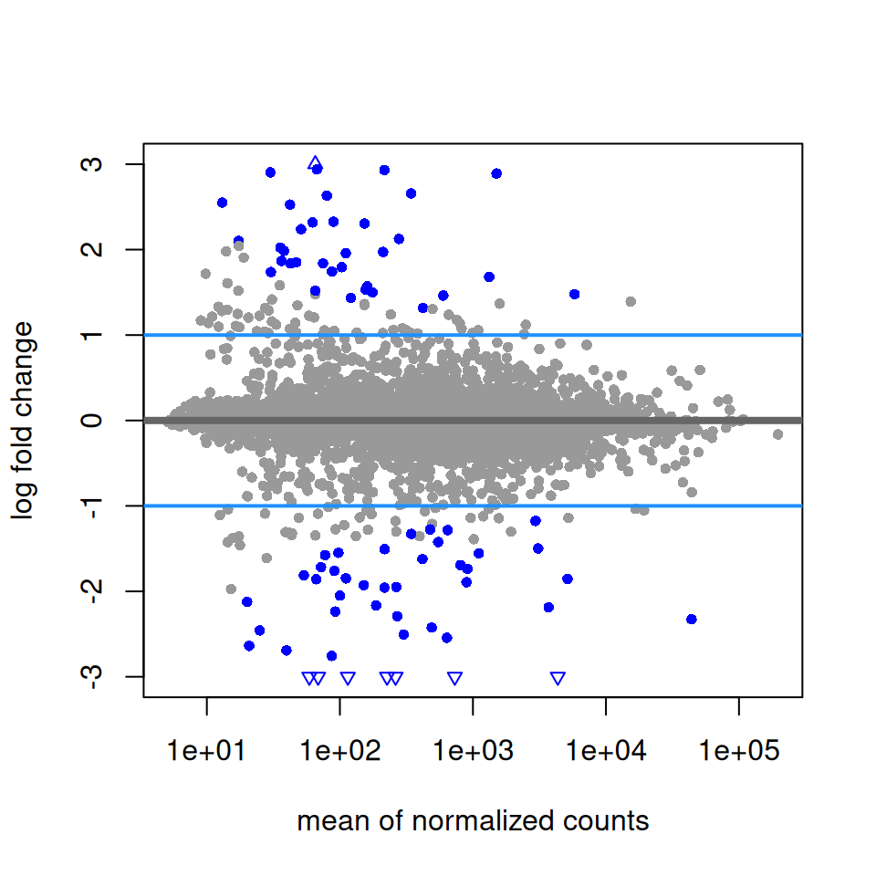
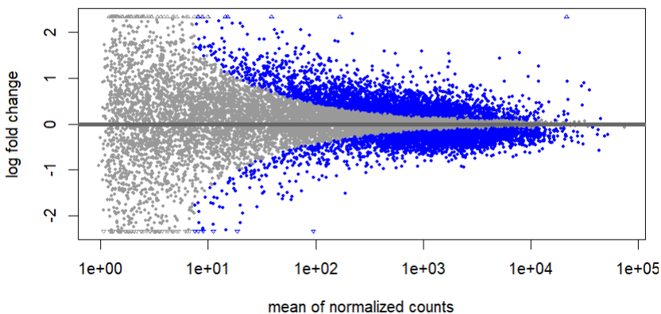
3.5 Interpretation and Visualization: lfcSE
shrinking log2FoldChange
only important for visualization
Imagine it like normalizing but for log2FoldChange
DESeq2 has three options: normal, apeglm, ashr
apeglm and ashr are better (but doesn´t really matter as it is only visualization. Sometime normal just looks better)
Notes:
Deseq2 documentation: https://bioconductor.org/packages/devel/bioc/vignettes/DESeq2/inst/doc/DESeq2.html#effects-of-transformations-on-the-variance

Slide 45
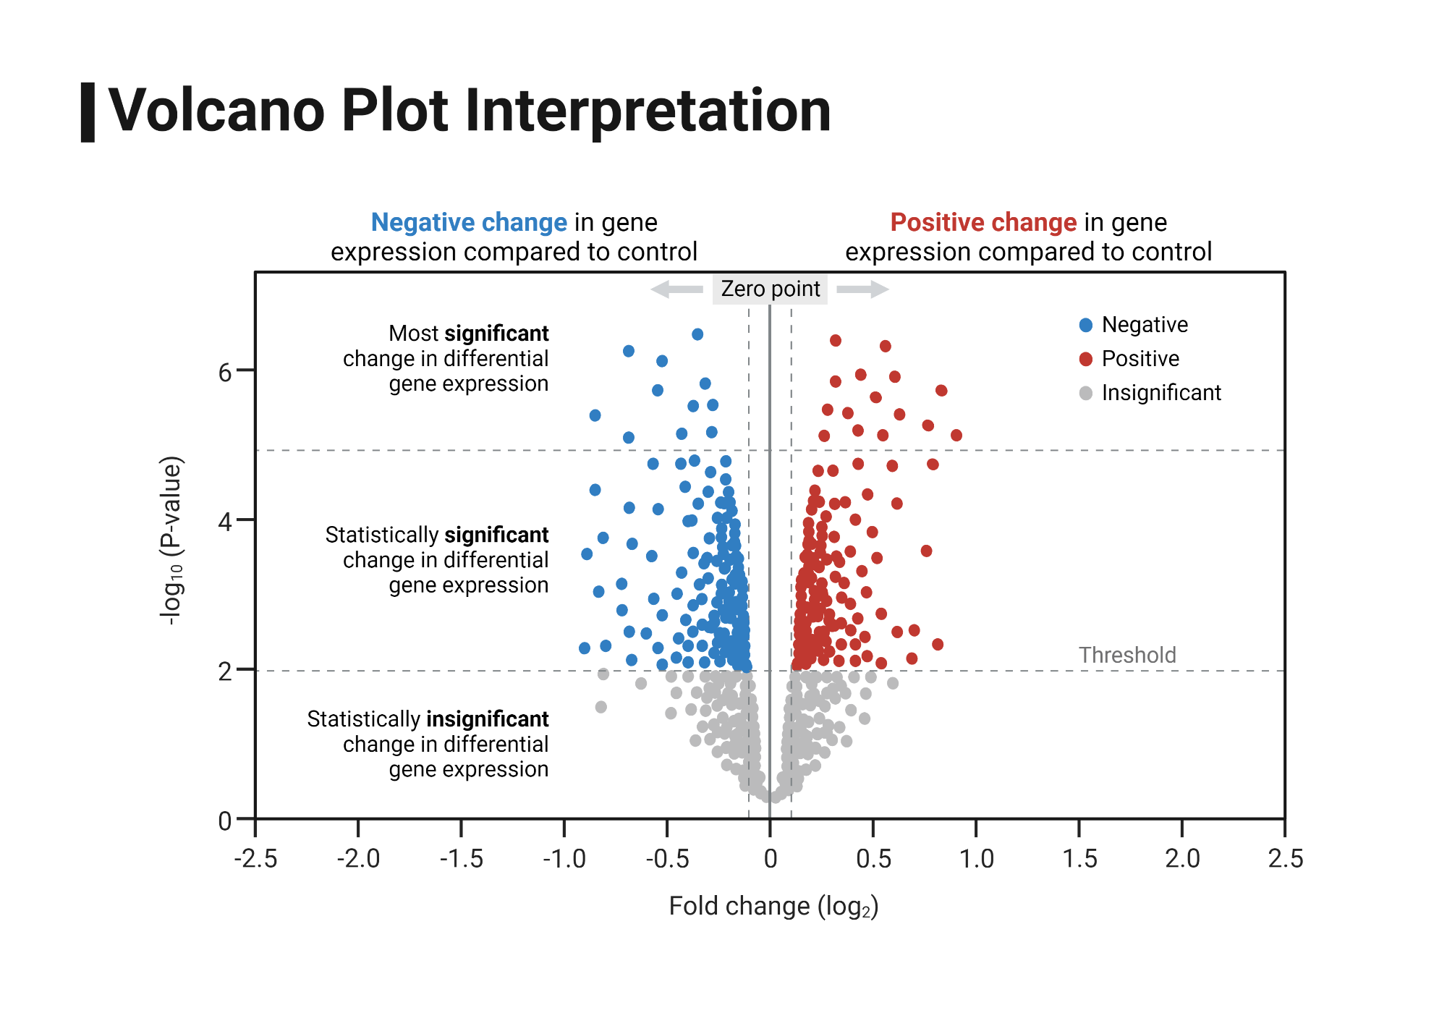
3.5 Interpretation and Visualization

Slide 46
4. Summary
DESeq2 is most used package for differential expression analysis
DEG analysis is a complex combination of linear modelling, distribution fitting and statistical models
Care for confounding batch effects and your design matrix
Always do multiple testing correction
Always check p-value histogram
log2FoldChange shrinkage is important for visualization
But visualization is only visualization! Does not change much in terms of significance or importance
the significance threshold is arbitrary and can include padj and log2Foldchange in differing values (but most just use 0.05 or lower of padj without log2FoldChange)
DESeq2 documentation should be your holy scripture!

Slide 47
Sources and extra I
Data: https://www.ncbi.nlm.nih.gov/geo/query/acc.cgi?acc=GSE50499
R and R studio: https://cran.r-project.org/ ; https://posit.co/products/open-source/rstudio/
Very good tutorial: https://hbctraining.github.io/DGE_workshop/schedule/1.5-day.html
Good example for modelling: https://www.youtube.com/watch?v=HK7WKsL3c2w
DESeq2 normalization: https://www.youtube.com/watch?v=UFB993xufUU
Good video explaining different kinds of classic normalizations: https://www.youtube.com/watch?v=S1PcT5rp8c4&pp=ygUVbm9ybWFsaXphdGlvbiBybmEgd2h5
Generally good channel for more technical explanations of topics: https://www.youtube.com/@statquest
sva paper: https://academic.oup.com/nar/article/42/21/e161/2903156?login=false
PCA main ideas: https://www.youtube.com/watch?v=HMOI_lkzW08
PCA step by step: https://www.youtube.com/watch?v=FgakZw6K1QQ&t=526s

Slide 48
Sources and extra II
Hierarchical clustering: https://www.youtube.com/watch?v=7xHsRkOdVwo&t=272s
Good tutorial about modelling: https://hbiostat.org/rmsc/mle
Explaining Wald test: https://www.youtube.com/watch?v=TFKbyXAfr1M
Explaining maximum likelihood: https://www.youtube.com/watch?v=XepXtl9YKwc (for more mathematical look for Ben Lambert)
Explaining Linear modelling: https://www.youtube.com/watch?v=R7xd624pR1A
Explaining Liklihood Ratio Test: https://www.youtube.com/watch?v=Tn5y2i_MqQ8
Deseq2 documentation: https://bioconductor.org/packages/devel/bioc/vignettes/DESeq2/inst/doc/DESeq2.html
Good basic explanation on pvalue histograms: http://varianceexplained.org/statistics/interpreting-pvalue-histogram/
Discussion on hill shaped histogram: https://support.bioconductor.org/p/71438/

